Slide 1

KNIME Presentation
Aashish Kumar

Slide 2
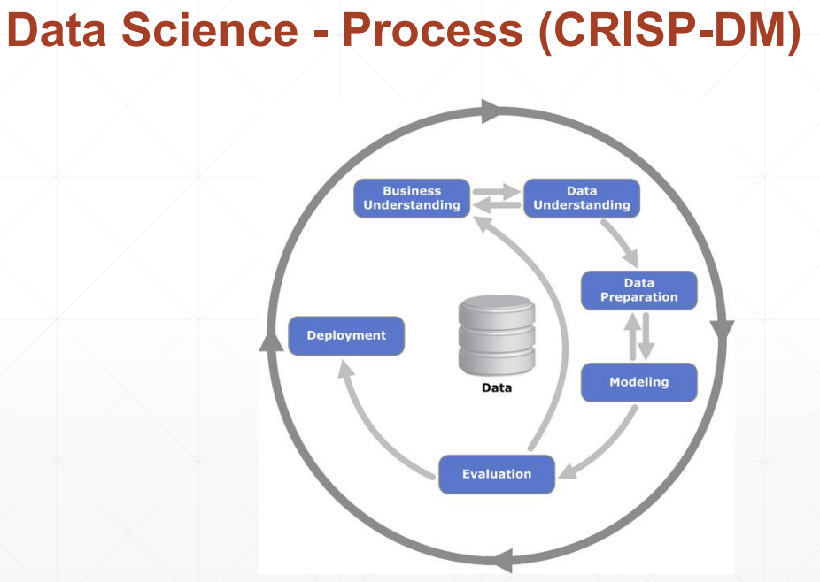
Following the CRISP-DM Model
Goal is to predict the popularity of news (High or Low) and get a higher F-measure score
Some columns such as weekdays could be irrelevant and need trial and error to verify relevance
The leaderboard judges using only 70% of the test data, using partitioning or binning might be useful

Slide 3
Business Understanding
This dataset summarizes a heterogeneous set of features about articles published by Mashable in a period of two years. The goal is to predict popularity. The dataset is the highly modified version of the dataset available on the UCI Repository
We use the readily available data to predict what upcoming article would be popular

Slide 4
Data Understanding
All columns are numeric except for row ID
There does not seem to be any data missing(should using missing node just to be safe)
Columns name reflect what aspect of information they store(for example num_videos: Number of videos)

Slide 5
Data Preparation
We use column filters, normalizers and other nodes in different combinations to prepare the most accurate and useful data
We make sure no values are missing
We make sure the data is relevant and no unnecessary data is being processed

Slide 6
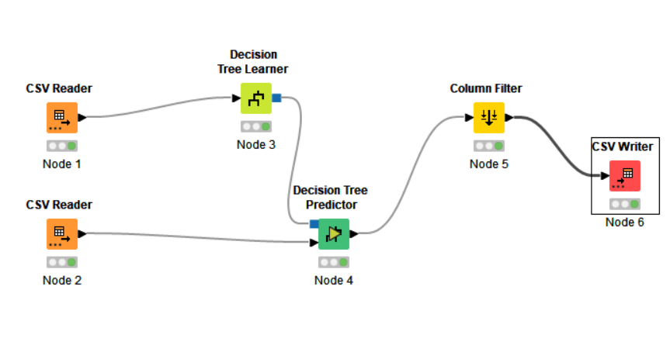
Modeling Attempt 1- F measure= 0.711 Attempt 2 – F measure = Decreased(used Gain ratio)

Slide 7
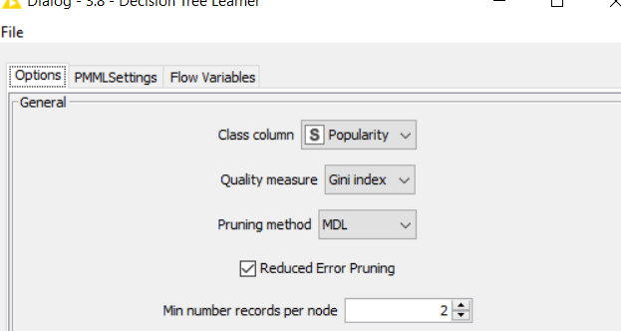
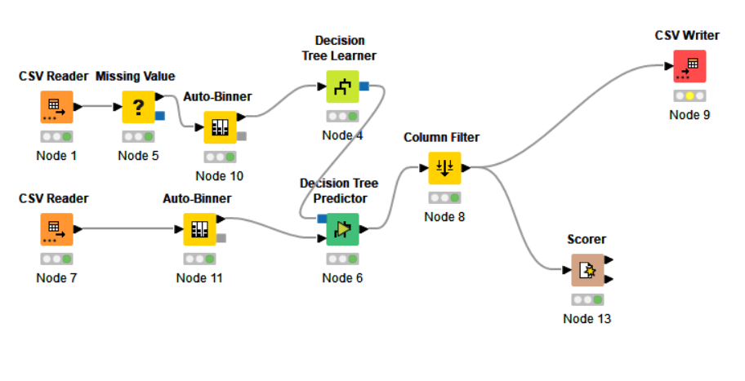
Attempt 3- F measure= 0.8055
Pruning method switched to MDL

Slide 8
Attempt 4-9 - F measure ~ Decreased
Pruning method switched to MDL and changed the min number records per node

Slide 9
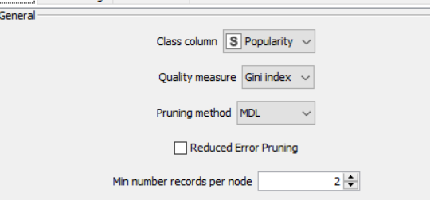
Attempt 10- F measure= 0.8111
Pruning method switched to MDL and no reduced error pruning

Slide 10
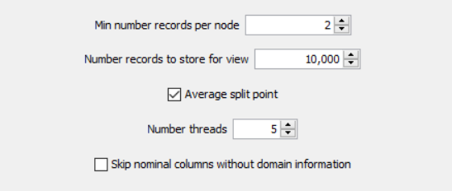
Attempt 11- F measure= 0.8166
Pruning method switched to MDL and no reduced error pruning and number of threads=5

Slide 11
Attempt 12-31 - F measure= Decreased
Pruning method switched to MDL and no reduced error pruning and changed the number of threads (from 3 to 8) and number records to store for view(5000 to 20,000)
Also used partitioning node inside of the Auto-Binner but results did not improve

Slide 12
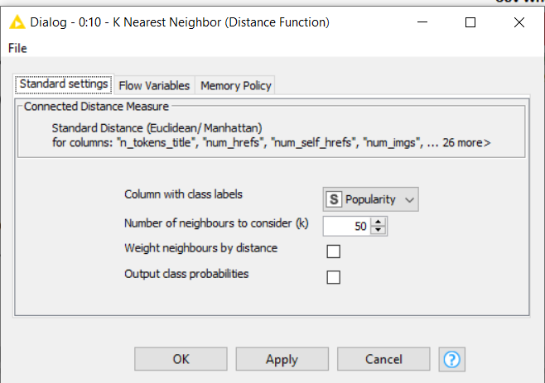
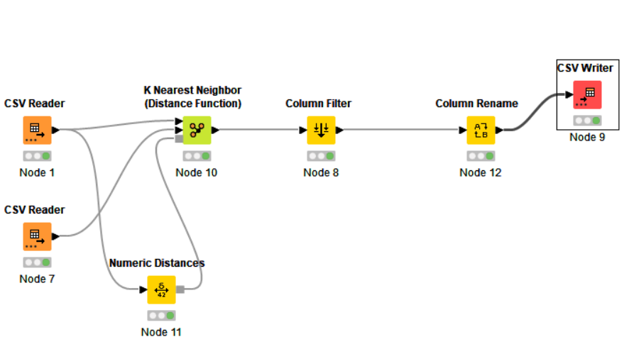
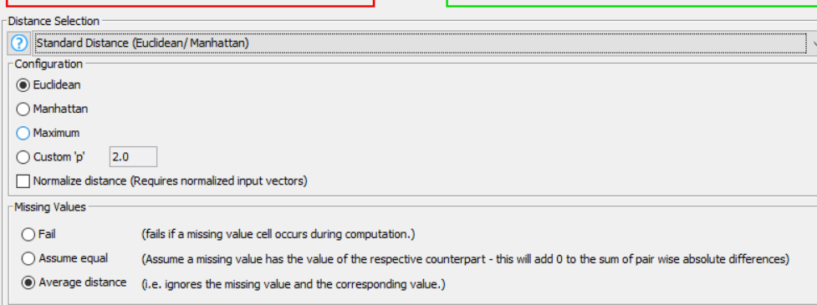
Attempt 32- F measure= 0.8166 Distance – Euclidean

Slide 13
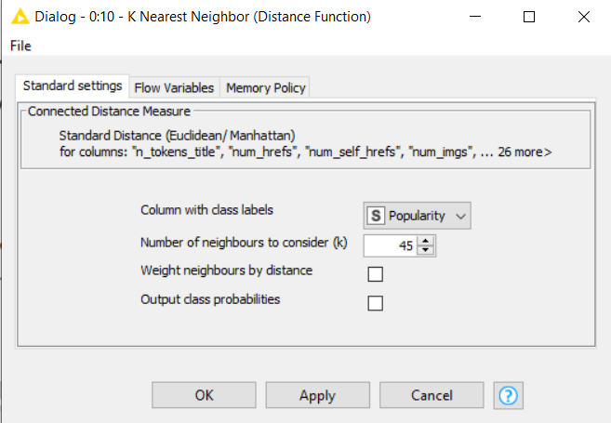
Attempt 33- F measure= 0.8111 Distance – Euclidean

Slide 14
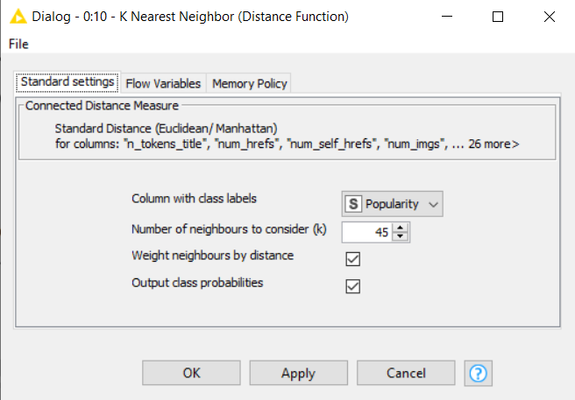
Attempt 34- F measure= 0.7833 Distance – Euclidean

Slide 15
Attempt 35-44- F measure= Fluctuate
Changed number of neighbors to consider(k) from 30 to 70
Switched to Manhattan distance
Used Column Filters to filter out irrelevant weekday columns but that did not influence the final result.

Slide 16
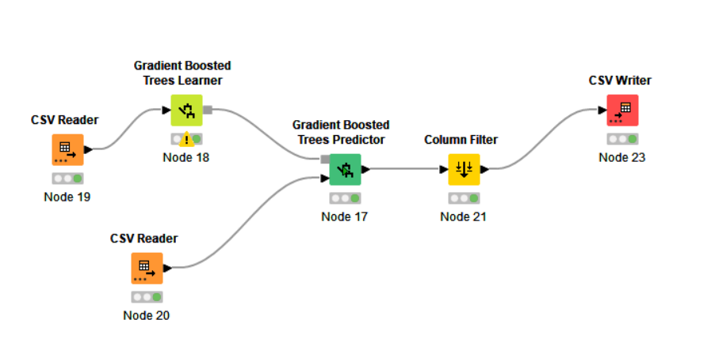
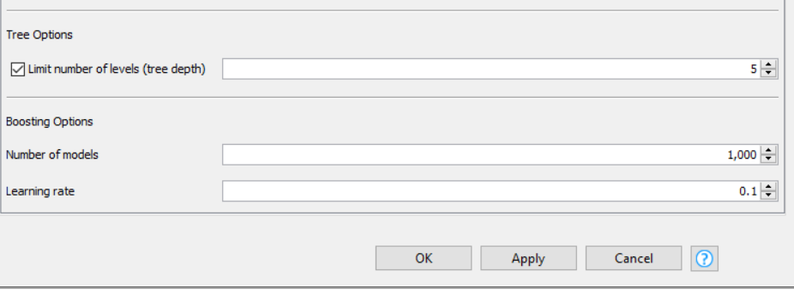
Attempt 45- F measure= 0.8222
Attempt 46-52- F measure= Fluctuate
Same result with Number of models=2,000
And at 5,000 it decreases to 0.8166
Increasing the depth to 8 decreased F-measure to 0.7888
Changing the learning rate to 0.01 decreased F-measure to 0.8000

Slide 17
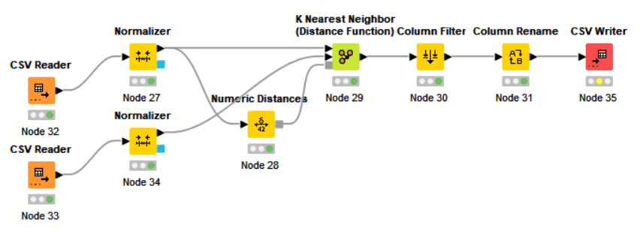
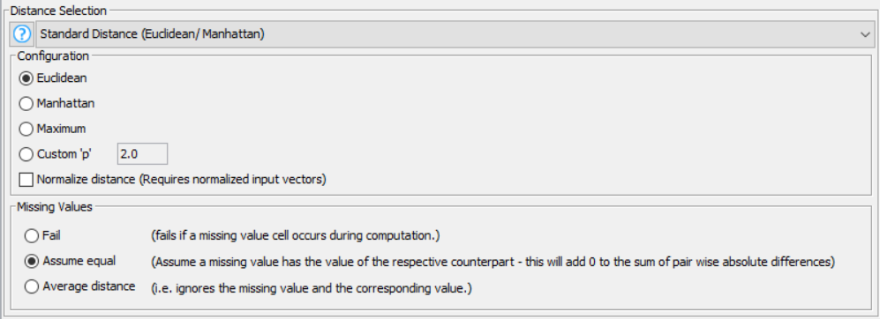
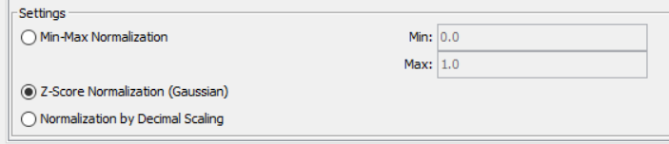
Attempt 53- F measure= 0.8222 (Best Attempt) Distance – Euclidean
Deployed/Uploaded

Slide 18
Evaluation
Since the F-measure was not increasing with Gradient boosted model
We went back to business understanding to restart the cycle
We finally land with the same F-measure with KNN model
We used normalizer node with KNN model to produced the highest F-measure score

Slide 19

Thank you!

